Slide 1



Machine Learning
Data Science Project
Telecom Churn Analysis

Slide 2
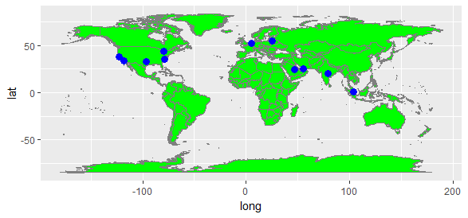
Team Info
Ali Qaiser Syed
Annada Prasad
Chia Aik Lee
Diego Jaramillo
Kiran Devathi
Manoj Kalamkar
Praveen Parvataneni
Subrata Roy
Ravi Bodkai
Vasudev Pendyala

Slide 3
Domain
Telecom
Topic
Telecom Churn Analysis
Churn (loss of customers to competition) is a problem for telecom companies because it is expensive to acquire a new customer and companies want to retain their existing customers. Most telecom companies suffer from voluntary churn. Churn rate has strong impact on the life time value of the customer because it affects the length of service and the future revenue of the company. For example if a company has 25% churn rate then, the average customer lifetime is 4 years; similarly a company with a churn rate of 50%, has an average customer lifetime of 2 years.
In the targeted approach the company tries to identify in advance customers who are likely to churn. The company then targets those customers with special programs or incentives. This approach can bring in huge loss for a company, if churn predictions are inaccurate, because then firms are wasting incentive money on customers who would have stayed anyway.

Slide 4
Introduction
Project Objective
To predict Customer Churn.
Highlighting the main variables/factors influencing Customer Churn.
Use various ML algorithms to build prediction models, evaluate the accuracy and performance of these models.
Finding out the best model for our business case & providing executive Summary.

Slide 5
Dataset Description
Source provided by Upx Academy for data science machine learning project evaluation
Source dataset is in txt format with csv.
Dataset contains 4617 rows and 21 columns
There is no missing values for the provided input dataset.
Churn_status is the variable which notifies whether a particular customer is churned or not. And we will be developing our models to predict this variable only.
Column Names
State | factor
Account_Len | integer
Area | integer
Ph_No. | factor
Int_Plan | factor
Vmail_Plan | factor
messgs | integer
tot_day_mins | number
tot_day_calls | integer
tot_day_chrgs | number
tot_evening_mins | number
Column Names
tot_evening_calls | integer
tot_evening_chrgs | number
tot_ngt_mins | number
tot_ngt_calls | integer
tot_ngt_chrgs | number
tot_int_mins | number
tot_int_calls | integer
tot_int_chrgs | number
cust_calls_made | Integer
churn_status | factor

Slide 6
Model Building Steps
Define Problem
Data Collection
Data Preparation
Feature Selection
Build Models
Validate & Measure Models Performance
Improve Models Performances
Execute Models for Prediction
Select the Best Fit Model for our Business Case
Perform EDA

Slide 7
Steps Description
contd..
In this project, we will be addressing Customer churn problem for a fictitious
US Telecom company. UpX academy has provided us the usage pattern for 4617 customers for over a period of time along with the info whether particular customer is churned or not.
Utilizing the input data, we have to build a model which can predict the customer going to be churned well in advance.
Define Problem
The input data has been provided by UpX academy in txt format with comma separated values. Read in the data into R workbook by appropriate methods ensuring without loosing the data. Here for this loading the data into R we have used read.table command with sep = ‘,’ . As columns names were not part of input dataset and we have provided them separately, hence we have provided the col.names as well to read.table command.
Data Collection

Slide 8
Steps Description
contd..
Perform general housekeeping activities such as checking for the completeness of the content, look at the dimensions & review the structure of input dataset, peek into the data, summarize the data, and get a snapshot of all the features. Check if there is any missing data for particular customers, luckily for our case there is no missing data.
As a final step, transform the data into a format ready to apply with the algorithms and modeling.
Data Preparation
Perform EDA (exploratory data analysis) to understand the data and its applicability on the problem. Understand how the data and its features are interrelated & correlated, evaluate presence of outliers and its effects. Here we will use various box plots and bar plots to understand what are the features which majorly impact on our outcome variable ‘churn_status’. We will see in our next slides the various outcomes from our EDA.
Perform EDA

Slide 9
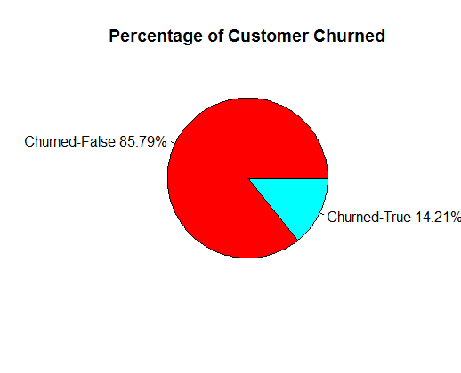
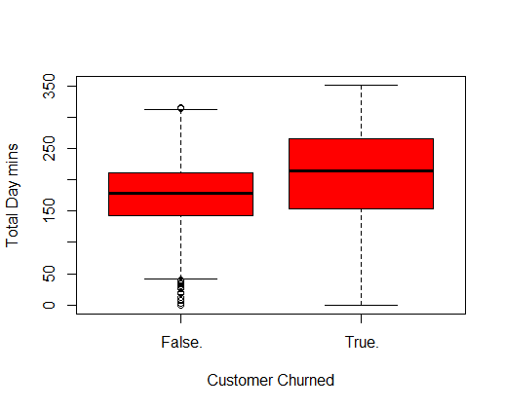
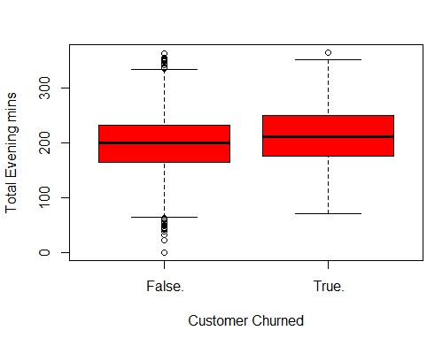
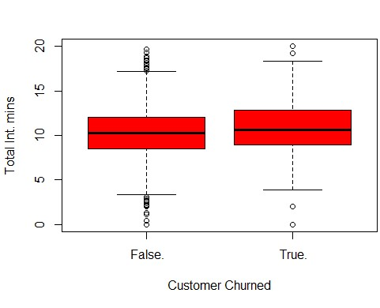
Steps Description
contd..
Perform EDA

Slide 10
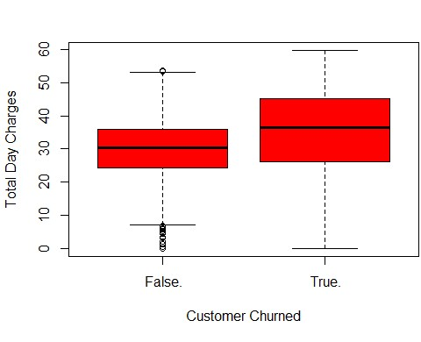
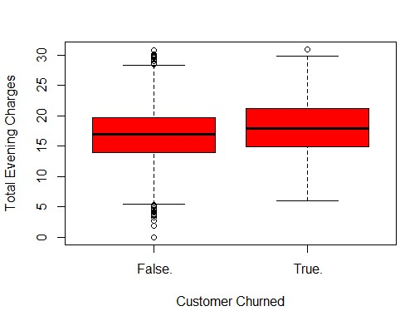
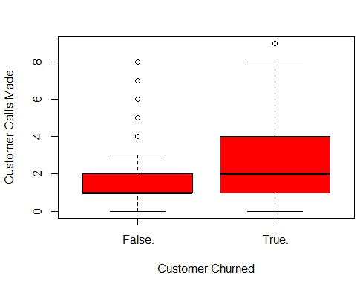
Steps Description
contd..
Perform EDA

Slide 11
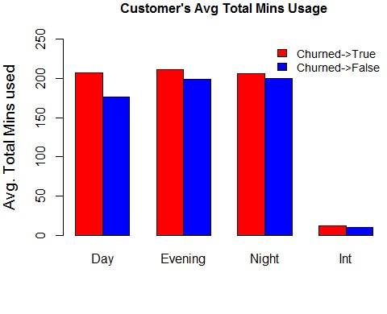
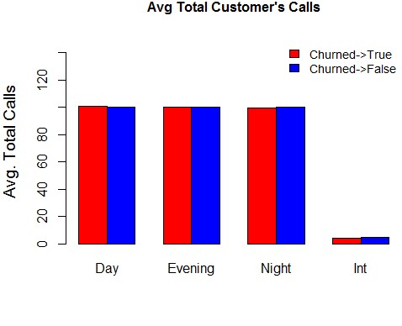
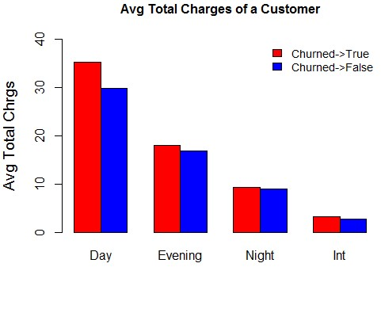
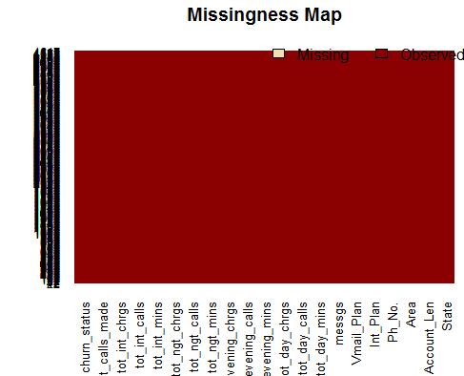
Steps Description
contd..
Perform EDA

Slide 12
Steps Description
contd..
Survival Analysis (Cox Hazard Method)
There are several Survival analysis methods which are applied to examine the time it takes for particular event to occur. For our business problem, we can make a case like, the time it takes for a existing customer to churn. As we have one of the input variable as Account_Length (in number of days) which denotes period of stay for a particular customer before he/she churned, our input data fits right for applying Survival Analysis.
Create a Survival Object & Cox Model:-
train_survival$survival <- Surv(train_survival$Account_Len, train_survival$churn_status == 2)
results <- coxph(survival ~ Int_Plan + Vmail_Plan + messgs + tot_day_calls + tot_day_chrgs + tot_day_mins +
+ tot_int_calls + tot_int_chrgs + tot_ngt_chrgs
+ tot_int_mins + cust_calls_made, data = train_survival)
Perform EDA

Slide 13
Steps Description
contd..
Survival Analysis (Cox Hazard Method)
Now lets see what does the summary stats from Cox Model convey us :-
coef exp(coef) se(coef) z p
Int_Plan yes 1.29e+00 3.64e+00 1.12e-01 11.53 <2e-16 Note:- From the summary
Vmail_Plan yes -1.74e+00 1.75e-01 5.54e-01 -3.14 0.0017 we can see that the
messgs 3.38e-02 1.03e+00 1.68e-02 2.02 0.0438 most statistically
tot_day_calls 1.14e-03 1.00e+00 2.50e-03 0.46 0.6480 significant coef are
tot_day_chrgs 8.29e+00 3.97e+03 1.73e+01 0.48 0.6314 Int_Plan_yes &
tot_day_mins -1.40e+00 2.47e-01 2.94e+00 -0.48 0.6336 cust_calls_made. Have
tot_int_calls -6.52e-02 9.37e-01 2.26e-02 -2.89 0.0039 also checked the
tot_int_chrgs -1.46e+01 4.47e-07 1.79e+01 -0.82 0.4131 Proportional Hazards
tot_ngt_chrgs 6.75e-02 1.07e+00 2.17e-02 3.11 0.0019 for these.(check R
tot_int_mins 4.03e+00 5.64e+01 4.82e+00 0.84 0.4032 code).
cust_calls_made 3.07e-01 1.36e+00 3.16e-02 9.72 <2e-16
Perform EDA

Slide 14
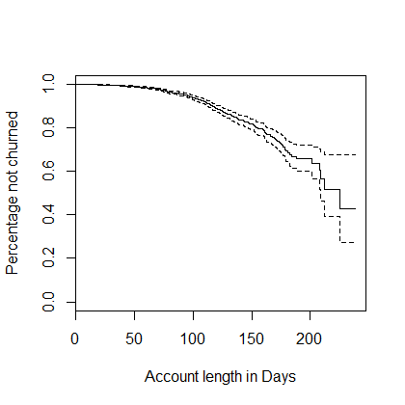
Steps Description
contd..
Survival Analysis (Cox Hazard Method)
Lets plot now the survival plot for our Customers.
So, from the figure we can see that for the first 50-70 days we have no customer churn, that means we are able to retain all of our customers in the first 50-70 days. For next 50-70 days the percentage of not churned reduces almost from 100% to 80% approx. And decreases considerably in such a way that, after 200 days of tenure the percentage of not churned comes down almost to 40 %. That means by the end of completing 200 days tenure, 60% of our customers are churned who joined us on day 1.
Perform EDA

Slide 15
Steps Description
contd..
Main Observations from our EDA
Usage pattern for Churned Customers which mainly includes minutes (Day/Evening/Night/Int) and their charges incurred is higher than the Not Churned Customers. So, Churned Customers seems to be relatively high value customers & more business relevant.
Both Box and Bar plots are complementing each other with their findings.
Box plot for Customer Calls made gives us enough proofs that customers going to be Churned Call Customer Care many times before getting churned.
Lucky enough to have no missing values in our input dataset.
From Survival Analysis it is confirmed that Customer Calls Made & International Plan are most influential features. Total Day Mins Used is the also one suggested by our traditional EDA methods.
Perform EDA

Slide 16
Steps Description
contd..
After EDA, its now possible for us to identify the major features/variables which influence significantly Customer Churn, we will now use these features for our model preparation. Further we can Drop the features that do/may not influence our outcome variable.
Feature Selection
Before starting with Building Model, we will segregate our input data in 3 datasets with proportions 60(train):20(test):20(pred for final prediction).
As our business case is for classification model, we will be building models for all possible ML algorithms which can be applied for Classification problem. Our approach will be to proceed with ML algorithm one by one and at the same time will be validating/improving the each ML algorithm outcomes.
Build Models

Slide 17
Steps Description
contd..
Logistic Regression
logit.model = glm(churn_status ~ Account_Len + tot_day_chrgs +
tot_evening_chrgs + tot_ngt_chrgs +
tot_int_chrgs + cust_calls_made, family = "binomial", data = train)
Build Models
Now lets Test the above build model on test dataset, as the model is a logistic regression we assume for any observation if the probability of customer to be churned is > 0.5 we will assume that customer is churned and similarly if < 0.5 , we will assume its not churned. Lets validate and measure our assumption .
Validate & Measure
Logit Pred
False.
True.
Accuracy
85.48
Specificity
Sensitivity
False.
741
115
115
98.27
10.15
True.
13
13

Slide 18
Steps Description
contd..
Variating the Threshold Value
In previous step we used our threshold value as 0.5 to decide whether customer is churned or not depending upon whether the value is above 0.5 or not. Lets variate the threshold value a bit and check if the performance of the model is increasing or not. Upon testing for various values (0.4 & 0.3), it was found that the performance of the overall model increases when threshold value is selected as 0.3 . We request you please refer to the attached R code for more details on this.
Improve Model Performance
Final Prediction with threshold value as 0.3 on pred dataset, and calculate the model performance for one last time for logit model.
Final Prediction
Logit Pred
False.
True.
Accuracy
84.21
Specificity
Sensitivity
False.
756
86
115
91.85
32.28
True.
67
41

Slide 19
Steps Description
contd..
K-nearest neighbour
knn_model <- knn(train = knn_train, test = knn_test,cl = train$churn_status, k=53 )
k= 53 has been calculated as the sqrt of number of observations 2785
Build Models
Validating the above model against our test data set, lets see what our confusion metrix and other performance parameters convey :-
Validate & Measure
Knn.Pred
False.
True.
Accuracy
87.55
Specificity
Sensitivity
False.
752
111
115
99.73
13.28
True.
2
17

Slide 20
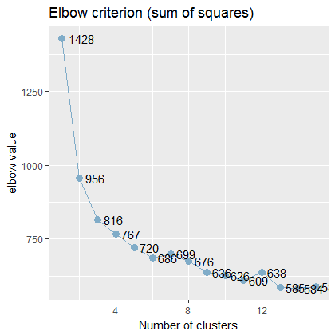
Steps Description
contd..
-> Using Elbow Method to identify
Optimum value of k.
-> Normalize the data to supress the
scale irregularities as knn works on
distance between the nearest neighbors.
Improve Model Performance
Final Prediction after applying above improvement techniques on pred dataset, lets calculate the Final model performance for knn algorithm
Final Prediction
Knn.Pred
False.
True.
Accuracy
89.26
Specificity
Sensitivity
False.
805
84
115
92.04
33.85
True.
18
43

Slide 21
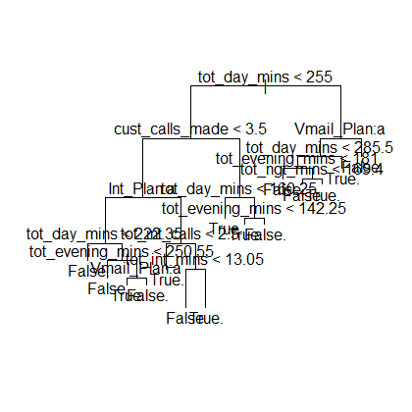
Steps Description
contd..
Decision Trees
tree_model <- tree(churn_status ~.-State-Area-Ph_No., data = train)
Classification tree: tree
Variables actually used in tree construction:
"tot_day_mins" "cust_calls_made" "Int_Plan" "tot_evening_mins" "Vmail_Plan“
"tot_int_calls" "tot_int_mins" "tot_ngt_mins" , Number of terminal nodes: 15
Build Models
Validating the above model against our test data set, lets see what our confusion matrix and other performance parameters convey :-
Validate & Measure
Tree.Pred
False.
True.
Accuracy
93.99
Specificity
Sensitivity
False.
739
38
115
98.01
70.31
True.
15
90

Slide 22
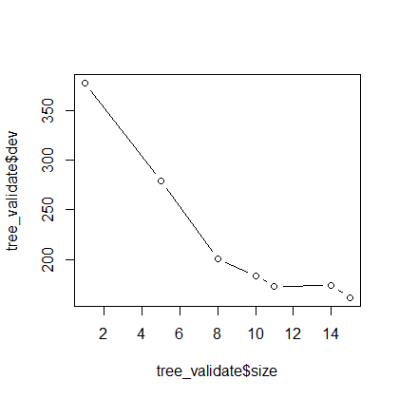
Steps Description
contd..
-> Pruning, so that the model doesn’t overfit the dataset.
tree_validate <- cv.tree(object = tree_model,FUN = prune.misclass )
plot(x=tree_validate$size,y=tree_validate$dev, type="b")
From the plot one can see that tree_validate$dev diff is same from for tree levels 11-14, so can we assume the best tree level size to be 12 (rather than original number 15) at the cost of some bias.
Improve Model Performance
Final Prediction after applying above improvement techniques on pred dataset, lets calculate the
Final model performance for decision trees algorithm
Final Prediction
Tree Pred
False.
True.
Accuracy
93.05
Specificity
Sensitivity
False.
801
44
115
97.32
65.35
True.
22
83

Slide 23
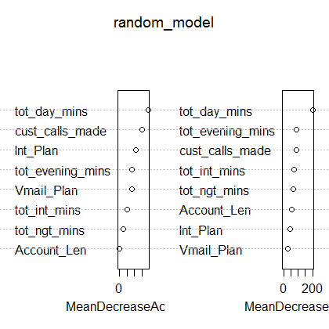
Steps Description
contd..
Random Forest
random_model <- randomForest(as.factor(churn_status)~ Account_Len + Int_Plan + Vmail_Plan + tot_day_mins + tot_evening_mins + tot_ngt_mins
+ tot_int_mins + cust_calls_made,data = train,ntree = 2000,
importance = TRUE)
Please note the variable importance plot also compliments our earlier findings from EDA.
Build Models
Validating the above model against our test data set, lets see what our confusion matrix and other performance parameters convey :-
Validate & Measure
Ran.Pred
False.
True.
Accuracy
94.10
Specificity
Sensitivity
False.
746
44
115
98.93
64.62
True.
8
84

Slide 24
Steps Description
contd..
-> Performance Boosting by Cross Validation with folds k=10.
train_control <- trainControl(method="cv", number=10)
random_model_train <- train(as.factor(churn_status)~ Account_Len + Int_Plan + Vmail_Plan
+ tot_day_mins + tot_evening_mins + tot_ngt_mins
+ tot_int_mins + cust_calls_made, data=train, method="rf",
metric="Accuracy", trControl=train_control)
Improve Model Performance
Final Prediction after applying above improvement techniques on pred dataset, lets calculate the
Final model performance for Random Forest algorithm
Final Prediction
Ran Pred
False.
True.
Accuracy
93.05
Specificity
Sensitivity
False.
808
47
115
98.17
62.99
True.
15
80

Slide 25
Steps Description
contd..
Support Vector Machine
svm_model<-svm(churn_status ,data=train,kernel='radial',gamma=1,cost=100)
SVM-Type: C-classification SVM-Kernel: radial
cost: 100
gamma: 1 Number of Support Vectors: 2785
Build Models
Validating the above model against our test data set, lets see what our confusion matrix and other performance parameters convey :-
Validate & Measure
SVM.Pred
False.
True.
Accuracy
85.49
Specificity
Sensitivity
False.
754
128
115
100
0
True.
0
0

Slide 26
Steps Description
contd..
-> Using Cross Validation technique to optimise the best values for gamma and cost.
svm.tune <- tune(svm,churn_status ~ Account_Len + Int_Plan + Vmail_Plan
+ tot_day_mins + tot_evening_mins + tot_ngt_mins
+ tot_int_mins + cust_calls_made,data=train,kernel='radial',ranges = list(cost = c(0.1,1,10,100,1000), gamma = c(0.5,1,2,3,4)))
Improve Model Performance
Final Prediction after applying above improvement techniques on pred dataset, lets calculate the
Final model performance for SVM algorithm
Final Prediction
Ran Pred
False.
True.
Accuracy
92.74
Specificity
Sensitivity
False.
813
59
115
98.78
55.54
True.
10
68

Slide 27
Steps Description
contd..
In the past few slides for our Classification Business Problem, we have created many models, measured their performances, applied various improvement techniques and at the end of each step we created best model for each corresponding ML algorithms. As we have the performance results with us for the models, lets select the best one out of them which suits best for our business case.
 | Logit | kNN | Decision T | Random F | SVM
Accuracy | 84.21 | 89.26 | 93.05 | 93.05 | 92.74
Specificity | 91.85 | 92.04 | 97.32 | 98.17 | 98.78
Sensitivity | 32.28 | 33.85 | 65.35 | 62.99 | 55.54
Select the Best Fit Model
Decision Trees (CART) model / Random Forest suits best for our business scenario.

Slide 28
Summary
contd..
Customers Churned were high business Value customers, their usage pattern was high as compared to not churned.
Analysis from Survival Model suggests that we are able to retain all our customers in our first 50-70 days, then in next 50-70 days we are able to retain 80% and further this % reduces to 40% by the end of 200 days.
Customers who are having International Plan OR those who call Customer Care for their service related queries churn more. These two factors are the most influential ones for a customer to be churned. So, one possible measure can be like company can always keep a check for all the customers who call Customer Care more frequently and can pool them in “Possible to be Churned Customers in future”, so that company can take their issues on priority or address them rapidly. Same measure/check can be implemented for International Plan Customers as well.
,

Slide 29
Summary
contd..
Out of various models developed for Prediction of Customers going to be churned, Decision Trees Model (CART) and Random Forest suits best for our business case. Both the models are almost similar w.r.t each other. The accuracy for both the models is almost same i.e. 93.05 %. The only difference between their performance is, RF is able to correctly predict 62.99% of customers to be churned as true but also with the false out ratio of 1.83%. That means apart from predicting 62.99% correctly it is also predicting incorrectly for some 1.83% customers as churned(which is not true).
Where as Decision Tree(CART) model is able to predict correctly 65.35% customers to be churned as true but also predicts incorrectly for some 2.68% customers as churned(which also is not true). So it depends upon Business which model it would like to use if it would like to go for higher predictive power at cost of some Fall Out ratio/error deviation Decision Tree is best. ELSE if company wants to stress more on minimizing error rate than RF can be the best bet.
,

Slide 30


In God we trust, all others must bring Data…..
Thank You

